Slide 1
General Data Protection Regulation (UK)
Marie Butler

Slide 2
What is the UK General Data Protection Regulation (GDPR)?
There are rules set out in law which all organisations, including community groups, must follow in order to help protect people’s data and privacy.
From the end of the Brexit transition period on 31st December 2020, the relevant legislation for organisations in the UK is the UK General Data Protection Regulation (UK GDPR), and the Data Protection Act of 2018.
Notes:
This applies to us all, as each of your groups are seen as one of a collection of groups which make up the whole of the Epsom and Ewell u3a
Our requirements are under the uk GDPR and not the European GDPR there are differences, but I am only going to talk about the uk requirements. The requirements are huge so I will limit it to what you need to know to run your groups.

Slide 3
Why should any of us care?
First the carrot:
Second the stick:
the legislation contains sensible provisions to make life better for individuals.
by ensuring compliance you should also be improving the quality of experience that people have when they engage with your group.
there are substantial fines for non-compliance..
Notes:
The Information Commissioner has the power to issue a monetary penalty for an infringement of the provisions of Part 3 of the Act – Law Enforcement Processing. Any penalty that we issue is intended to be effective, proportionate and will be decided on a case by case basis.
The maximum highest penalty is £17.5 million with the standard maximum being £8.7 million- so you can see why big companies employ IT security and their own hackers

Slide 4
Data must be collected Lawfully, fairly and transparently
The person must understand why you require their information and have consented to you collecting it
You should be clear about what you’re going to do with the information
Do you keep a record of consent?
Notes:
Have agreed or consented
Be clear Why you are collecting information and what you are going to do must be made clear. For example, if you are collecting email addresses, postal addresses and phone numbers, let the group member know this is to contact them with meeting and event schedules remember consent is only valid for the particular purpose it was gained for (e.g. if you gain consent to use someone’s address to send them a newsletter, it does not mean you have consent to use this information for other purposes). People must be well-informed in order to give consent. You must explain why you need the data and what you will use it for, and that the person can ask for it to be deleted in future

Slide 5
Top Tip
Consent Statement
We’d love to keep in touch with you by email and phone to let you know about our meetings and events.
We will only share these details to keep in contact about the group, and will not share them with any one else. Please tick the box to tell us you are happy to receive emails
If you want to stop hearing from us at any time, please let us know by emailing
[Insert group email address]
Notes:
Do use this statement to record consent – use we if you all take responsibility for the group but if it is solely one person then use I
Don’t collect data without asking for consent first.
There are different types of data we need to understand

Slide 6
personal data
Personal data is information about a person which is identifiable as being about them.
Name
Home Address
Telephone Numbers
Emergency Contact Details
Email address
An identification card number
Notes:
There are two definitions of data. Firstly Personal data is information about a person which is identifiable as being about them... This is likely to include names and contact details,

Slide 7
Sensitive Data/”Special categories of personal data”
This is more complex or sensitive information such as:
race;
ethnic origin;
political opinion;
religious or philosophical beliefs;
trade union;
biometric data
health data;
sex life; or
sexual orientation.
Notes:
The second type of data is sensitive data, which is called by the UK GDPR as “special categories of personal data” such as health information . You shouldn’t need to collect or store this data as part of being a group leader, but it’s important to recognise the difference between personal and sensitive data as there are extra rules on how sensitive data must be handled. Processing of this data has to comply with other principles and requirements of the uk GDPR. Article 9 lists the conditions for processing special category data, which includes employment organisations, not for profit organisations, social care etc. who all might need this sensitive data to ensure equality of opportunity or treatment, support for individual with a medical condition, insurance etc.. As with personal data generally, it should only be kept on laptops or portable devices if the file has been encrypted and/or pseudonymised.

Slide 8
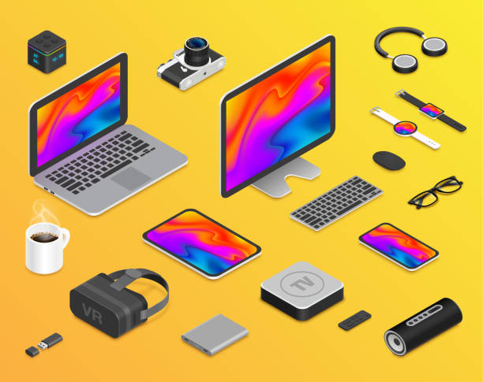
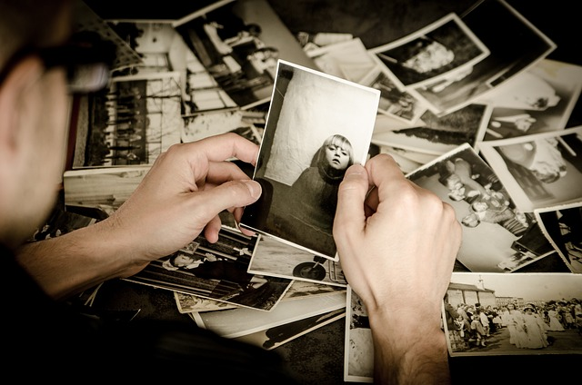
Personal data can be held:
Electronically or on paper. Photographic and film images are also considered to be personal data if people are identifiable in them
Personal data must be stored on a password protected computer in a locked folder. Your computer must have up-to-date software to protect from malware and viruses
Paper data must be stored in a locked cabinet.
Do not leave personal or sensitive data unattended so that others can see it. For example, left on a table after a group meeting.
Notes:
Personal data can be held electronically or on paper. Photographic and film images are also considered to be personal data if people are identifiable in them. All these pieces of data have to be kept secure and disposed of securely when necessary. We are going to discuss photography later on.
If your group keeps personal data on a computer, your computers should be password protected. You should have up-to-date software to protect them from malware and viruses. If you store information on paper, it should be filed securely
Avoid keeping data for the group on an ad-hoc basis in personal phones and address books. If you write down someone’s details when you are out and about, add them to the central list and then delete them from your private phone or address book.

Slide 9
What is your group’s purpose for collecting, storing and using personal data?
Organisations should only collect, store or use personal data if they have a clear purpose for doing so. This means that your group must know why you have people’s personal data. If there is no longer a purpose for holding someone’s data, it should no longer be kept.
Here are some examples.
Sing Together Group Leader needs to send information to his members about upcoming rehearsals. To do this, he needs people’s names and email addresses. However, he possibly does not need to know people’s home addresses.
Church Crawlers are holding a party. To do this, they need dietary information about members so that they are aware of food allergies. Once the event is over, they don’t need this information any more, so it should be carefully deleted
Notes:
Ask yourself what the purpose of collecting the data is before you collect it. Do you really need it?
Once you have finished using personal data for the purpose it was collected for, it should be deleted. It should not be kept indefinitely just in case you want to use it again but don’t know what for. When you delete data, make sure it cannot be accessed by someone else.
Once the trip is over they no longer need this information so there is no need to keep hold of it. Data that was held electronically is permanently deleted from the computer. Paperwork with health information on it is shredded.
You should also delete people’s data when they ask you to, unless you need to keep it because of a specific legal obligation. If you send out emails to a list of contacts, you must put information at the end of every email explaining how to unsubscribe from the list. If you send ordinary emails to a list of people, create an email signature which tells people who they should contact to be removed from the list.

Slide 10
Data should be accurate and kept up to date
TOP TIP
Do
Regularly check that the information you hold is accurate and up to date and delete or remove information you hold immediately when asked to do so by the individual or it is no longer needed.
Don’t
Assume the information you collected awhile ago is still correct.
Notes:
Every reasonable step must be taken to ensure that personal data is inaccurate is deleted or rectified without delay

Slide 11
Sharing personal data with others
You should request explicit consent if you wish to share personal data with third parties, (unless you need to do so to comply with the law or protect someone’s life). Third parties might be other organisations, but they might also be members of your own group. Each individual in a group is separate from the group itself, and data should not be shared with group members to use in a personal capacity without explicit consent.
Take care not to accidentally share personal data, including with other members of the group. For example, if you send an email to everyone on your mailing list, do not simply type all the email addresses into the “To” field. By doing this you are actually sharing all the email addresses with everyone on the list. Use the “Bcc” field instead. This hides everyone’s email addresses.
Notes:
Your group can use people’s personal data in order to protect their life or someone else’s life.
For example, it is okay to share information about a relevant health condition with paramedics if somebody is unable to communicate for themselves, in order to help save their life.

Slide 12
Does personal data belong to the group or to you?
It is important to understand whether personal data belongs to a group or to you personally.
A good rule of thumb is to consider whether you met a person, or gained their information, in the course of your involvement with the group. If you know someone because of your role in a group, and have only gained the information through running group activities, the data you hold about that person belongs to the group and not to you personally. You should not use it for personal reasons without explicit consent
Notes:
I meet person A during a group activity and I gain information about where they live as I overhear the group organiser writing down their address. This information has been gained from my involvement in the group-so that data belongs to the group and I can not store the person’s address. However, if person A talks to me and says come round and gives me their address the data has been given with permission and it can be stored by me in my address book.
Another example a group leader runs a group and then decides to leave, they cannot use the data they have to contact people in the group, as the data was obtained to run the group. The group leader has to delete the data from any personal electronic or shred paper copies. If the group is still to run they have to have the members permission to pass on their details to the next group leader. If you wanted to keep in touch and use the data you have to ask your previous group members explicitly if you can keep in contact with them.

Slide 13
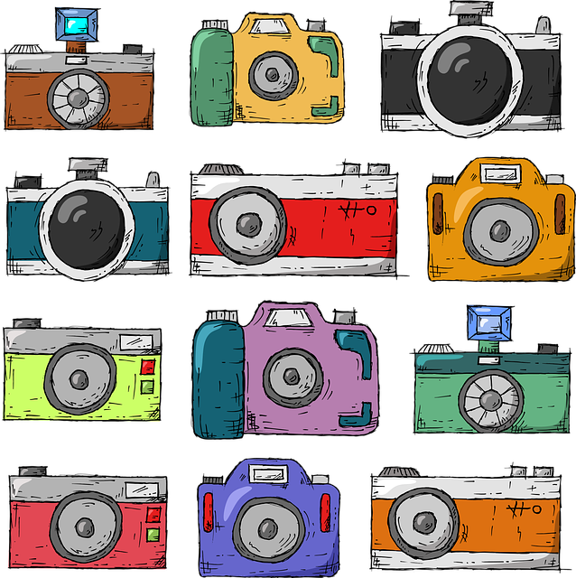
Images in which people can be identified are a form of personal data.
The most important thing to remember about all forms of personal data, including images, is that you should only collect, store and use data that your group needs for a specific purpose. You shouldn’t collect, store and use data just because you might want it at some point in future. This means that you should only take photos if you know why you need them and how you will use them. You should delete photos once their purpose is done. You shouldn’t store them indefinitely “just-in-case”.
Notes:
Images are protected by data protection legislation, which sets out how organisations should treat people’s personal data in order to respect their privacy.

Slide 14
Tell people you are taking photos
Before taking any photos or videos, you should ensure the people them are aware that they are being photographed, who is taking the pictures, what they will be used for, and who they will be shared with. You should also tell people who they should contact if they do not want to be photographed, or if they want their images deleted later. Display clear signs at your event which specifically explain all this. For example:
U3a dancing group will be taking photos at today’s session. These images will be used by the committee to share news about our dance group, and to publicise it. Images may be published on the Epsom and Ewell u3a Facebook Page and in the Chair’s newsletter. They will be stored securely for one month, after which the photos will be deleted. If you would prefer not to be photographed, please speak to Rob Dance (123 4567 8910) If you would like to see your images, or would like us to delete them, please email the group on rob dance@happyfeet.org.uk at any time.
Notes:
Make sure your signs are clear and big.

Slide 15
Sharing images with members of your group
Sometimes, when you take pictures at an event, people ask to be given copies. It is fine to share photos so long as everyone knows this will happen. You should make it clear on your signs, so you would add for example:
We may also share photos with members of the dance group for their personal use.
When you share photos with people, you need to make sure they understand that they are for their personal use only, and should not be shared more widely (e.g. should not be put on Facebook). You could ask people to sign something to say they understand this. For example:
I have received images from Rob’s dance group. I understand that these are for my personal use only, and I will not publish them or post them online anywhere.
Name:
Phone number:
Signature:
Date:
Notes:
Copyright rules mean that photos, films and other media can only be used with the permission of the person who created them. So, if someone takes photos at your event, those photos are the copyright of the person who took them, and should only be used with their permission. This applies even if the person is taking the photos on behalf of your group, as a volunteer.

Slide 16
Sharing photos with third party organisations
You may wish to share photos with other organisations, such an event venue that you have attended.
Make sure people know if this will happen. You should tell people who the images will be shared with, and for what purpose. For example:
We may also share photos with Epsom community centre (www.epsomcommunitycentre.org.uk), who we have hired our hall from, for use in their printed and online publicity.
Before sharing photos with a third party organisation, make sure the organisation understands what they can use them for. The photos should only be used for the purposes you have told people about. You should also check that the photos will be stored securely, not kept for longer than needed, and that the organisation will delete the photos in future if you ask them to. Keep track of which photos you have shared, because if someone asks you to delete their picture you will need to pass this message on to any third party organisation you shared it with.
Notes:
Sometimes we attend a venue on a trip or the coach company, etc ask for photographs for their website. Make sure people know this will happen, if you are asked and the purpose for the organisation is going to use the images. Be specific as what the organisation can use them for and keep track of which photos you have shared.

Slide 17
Contract
A contract doesn’t have to be a formal written agreement. It can simply be providing a service or product to someone that they have asked for and you have agreed to, or paying someone to run a service for you. You should not keep information you no longer need once the contract is completed. Here are a couple of examples:
The Jazz Group sells t-shirts to raise money. When ordering t-shirts, people provide their clothing size. The group can use this information in order to get the t-shirts made. They should delete the information once they have provided the t-shirts, because they no longer need it.
The Social Committee arranges speakers to come to give talks monthly. They need the name and contact details of the speakers so that they can contact them to arrange sessions, and send them payment. The information is stored securely by the treasurer.
Notes:
Your group can use personal data in order to make or fulfil a “contract” with someone. And sometimes this data is sensitive data which can be linked to a person.

Slide 18
People’s right to their own data
Individuals have a right to be given a copy of their data, and information about how it is being used. This must be provided within one month of a request. They also have a right to have their information amended or deleted within one month of a request (unless you need to keep it for legal reasons).
Notes:
To help you do this, make sure you know where data is being stored, and by who.

Slide 19
If you have not protected someone’s data properly
There are lots of ways that a group might have a “data breach”. These include, for example:
Theft of a laptop or phone with contact details stored in it;
Accidentally sending an email with everyone’s email addresses visible;
Sending personal information to the wrong recipient by mistake;
Losing a paper sign-up sheet on which people have written their names and addresses;
The most important thing is to recognise if something has gone wrong, so that you can take steps to reduce the impact it will have, and to avoid it happening again in future. Try to keep data protection in mind, so that you notice if there has been a possible data breach.
Notes:
If you have a data breach, the first thing to do is try to get the data back. For example, if you have accidentally emailed someone’s details to the wrong person, contact that person and ask them to delete the information.
The next step depends on whether the data breach is likely to have a significant impact on someone’s life. If it is not likely to have an impact, you should still record that it has happened and take steps to avoid it happening again.
For example, a group organising a weekly sewing meet-up keeps a list of email addresses of people who attend regularly. A group organiser stores the list on her mobile phone. Her grandchild is playing with her phone, and accidentally sends a meaningless email to one of the contacts. This is not likely to risk anybody’s freedoms or rights, and therefore does not need to be reported to anybody. Instead, the record what happened in the minutes of the next meeting at which it was discussed, and puts in place a system to avoid it in future (by storing the list in a more secure place).
Some data breaches are more serious though, and need to be reported to the person whose data is affected and to the Information Commissioner’s Office (ICO). However, you are very unlikely to have information but if you are concerned please contact Tony. If you feel it is a serious breach it must be reported to Tony immediately as he will only have 72 hours to inform the Information Commissioner’s Office
Remember that it is much better for the ICO to hear about your data breach from you than from someone else. This will show them that you are a responsible organisation that takes data protection seriously, which makes it less likely they will have significant concerns about you or issue a penalty fine. Remember that large fines are not intended for small groups, but that data protection is for everyone.

